Slide 2
Containers in Azure Your first steps
Vladimir Stefanovic
Microsoft Azure MVP
Cloud Solution Architect @SuperAdmins

Slide 3

Who am I
vladimir@Azure:~$ az speaker show
{
"speakerName": "Vladimir Stefanovic",
"location": "Belgrade, Serbia",
"titles": "Microsoft Azure MVP, MCT Regional Lead",
"position": "Cloud Solution Architect @SuperAdmins",
"twitter": "@wladinho31"
}

Slide 4
Agenda
Containers vs. Virtual Machines
The benefits of using containers
Running Containers in Azure
Docker VM vs. Azure Container Instances
Multi-container Groups
Azure Container Registry

Slide 5
Containers vs. Virtual Machines
App 1
App 2
App 3
App 4
App 5
App 6
IIS, Apache, Nginx...
Guest OS
Guest OS
Guest OS
Container Engine
Windows, Linux...
OS / Hypervisor
Hyper-V, Vmware, Xen, KVM...
Physical server
Machine virtualization

Slide 6
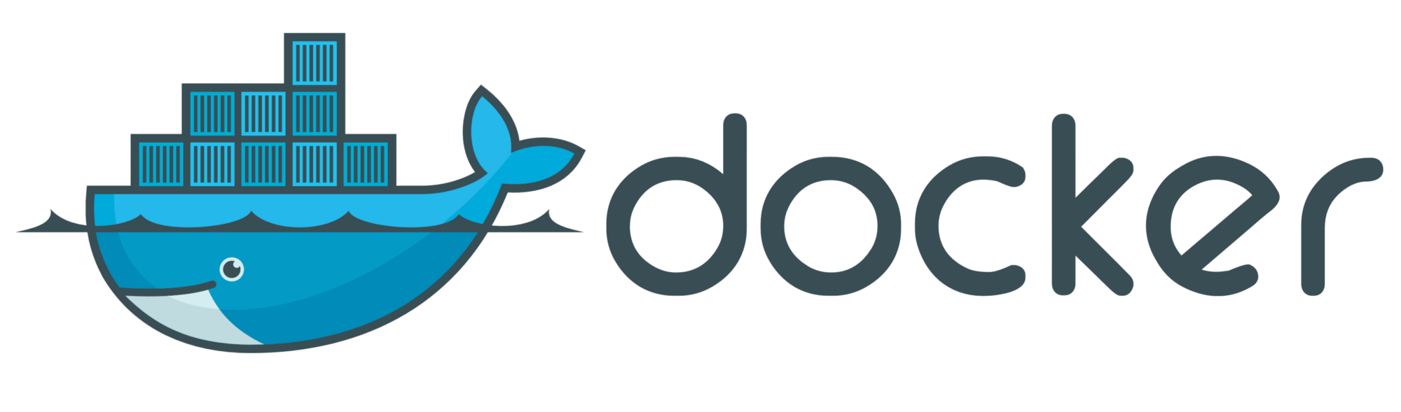
Containers vs. Virtual Machines
App 1
App 2
App 3
App 4
App 5
App 6
IIS, Apache, Nginx...
Container Engine
Operating System
Windows, Linux...
Physical server
OS virtualization

Slide 7

The benefits of using containers
A container is a standard unit of software that packages up code and all its dependencies, so the application runs quickly and reliably from one computing environment to another...

Slide 8
The benefits of using containers
Less overhead
Containers require fewer system resources than virtual machines because they don’t include an operating system
Increased portability
Containerized apps can be deployed easily and quickly to multiple different platforms
Better efficiency
Containers allow applications to be more rapidly deployed, patched, or scaled

Slide 9
Running Containers in Azure
Docker on Azure Virtual Machine
Web App for Containers
Azure Container Instances
Azure Kubernetes Service
Containers for Azure Batch
Azure Service Fabric

Slide 10
Running Containers in Azure
Docker on Azure Virtual Machine
Azure Container Instances

Slide 11

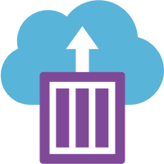
Docker VM vs. Azure Container Instances
Docker on Azure VM
Self-managed Docker infrastructure
Supported OS: CentOS, Ubuntu, CoreOS, Redhat
Instead of installing Docker components on Azure VM, you can install a Docker extension
Azure Container Instances
Run containers without managing servers
Deploy containers with a single command
Secure applications with hypervisor isolation
Elastic bursting with AKS

Slide 12
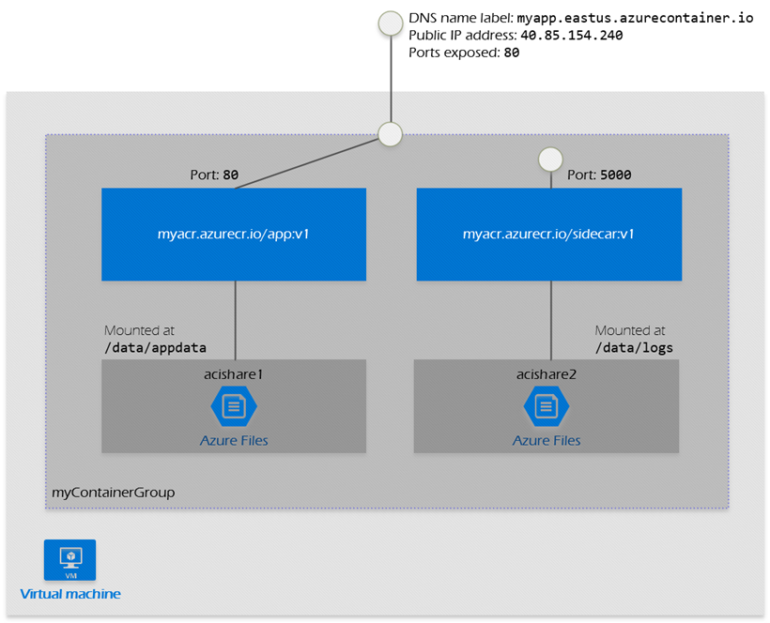
Multi-container Groups
The top-level resource in Azure Container Instances
Collection of containers that get scheduled on the same host machine and share a lifecycle, resources, local network, and storage
Two common deployment ways
ARM template
YAML file

Slide 13

Azure Container Registry
Fully-managed, private Docker registry service based on the open-source Docker Registry 2.0
ACR Tasks are used to streamline building, testing, pushing, and deploying images in Azure
Registries are available in three SKUs
Basic
Standard
Premium

Slide 14
Demo

Slide 15
Thank you for your attendance

